Slide 1

LESSON 2 – Lean on
For my sweetheart

Slide 2

Summary
The, This, That, Those, These, Brother, Father
Think, Thing, Nothing, Everything, Something, Thanks, Thank you, Three

Slide 3
Summary
-abide by – agreement – assurance
- cancellation - determine
- engage – establish – obligate - provision
- Resolve - specific

Slide 4
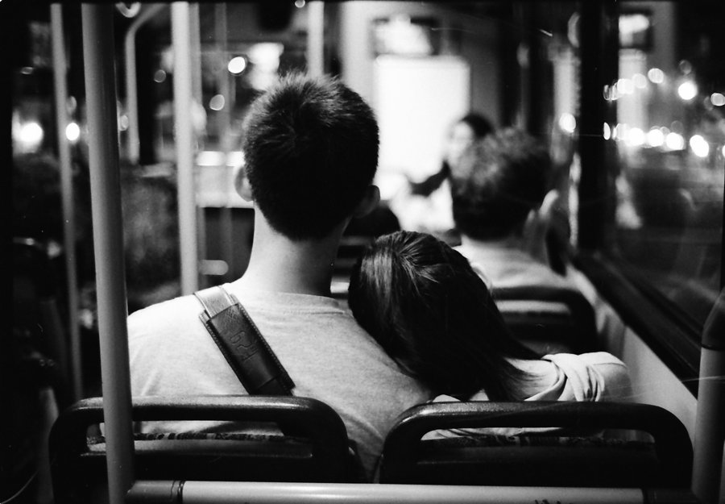
lean on
leaning on
She’s leaning on the pillar
We need someone to lean on

Slide 5
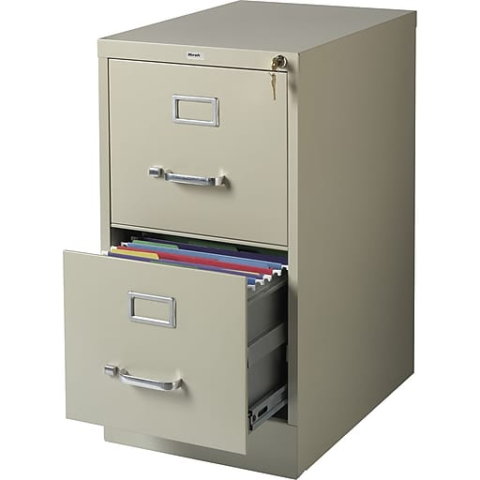
cabinet
How to say i How to say e
(kha bơ nịt)
filing cabinet

Slide 6
box
boxes

Slide 7
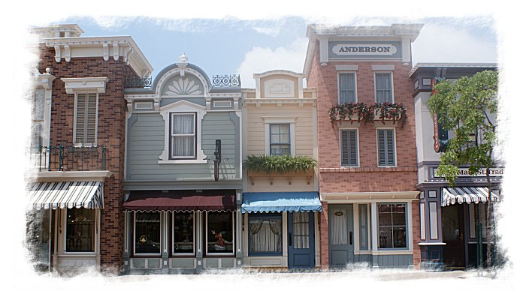
close
closed
The filing cabinet is closed
close to
My house is close to your house

Slide 8
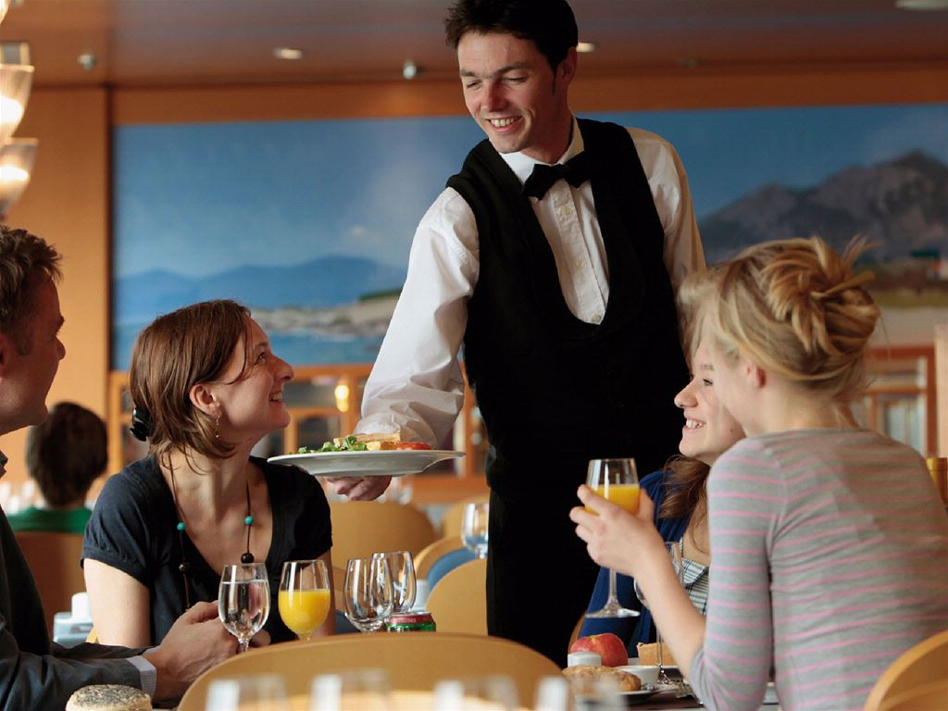
serve
They are being served by the waitress
The man is serving the customers

Slide 9
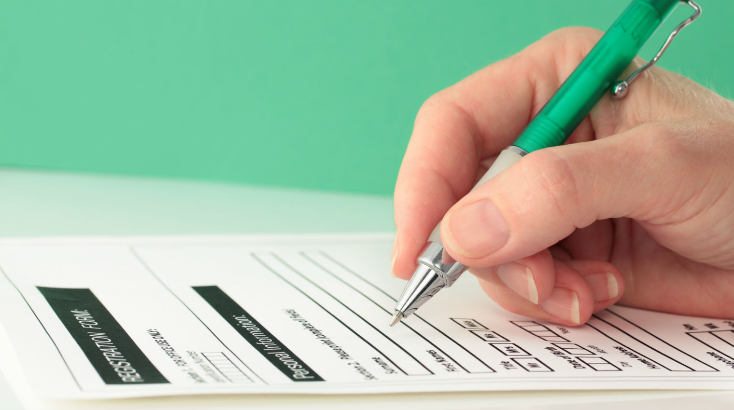
fill out
filling out
He is filling out a form

Slide 10
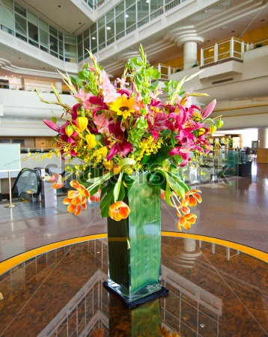
vase
There is a vase on the table
There are 2 vases on the table

Slide 11
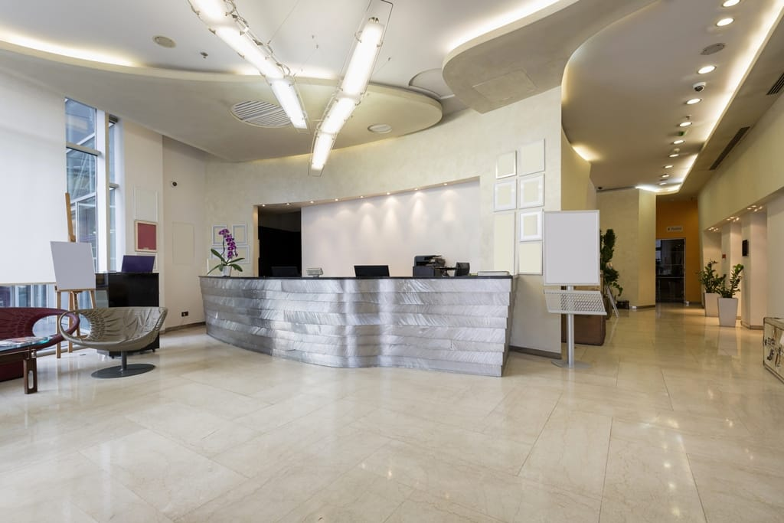
lobby
I’m standing in the lobby

Slide 12
Go on to the next page

Slide 13
http://www.onthitoeic.vn/part-1-level-350-500-bai-luyen-tap-50/

Slide 14
Song lean on on youtube

Slide 15

That’s all

Slide 16
Thanks!
Any questions?
You can find me anytime

